Slide 1
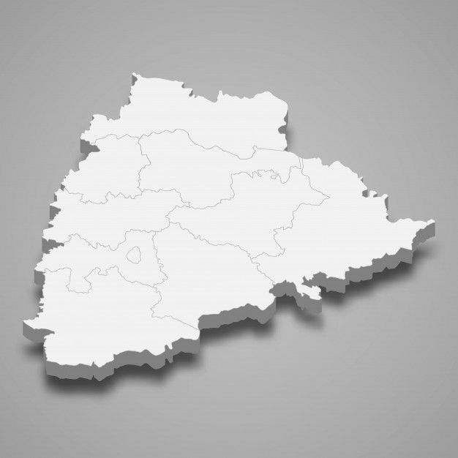
PROVIDE INSIGHTS FOR TELANGANA GOVERNAMENT TOURISM DEPARTMENT
Presentation by
Sai Parthish Mandumula

Slide 2
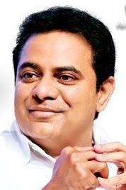

Special Thanks To
Code Basics (Online Learning Platform)
K T Rama Rao(Telangana IT Minister)

Slide 3
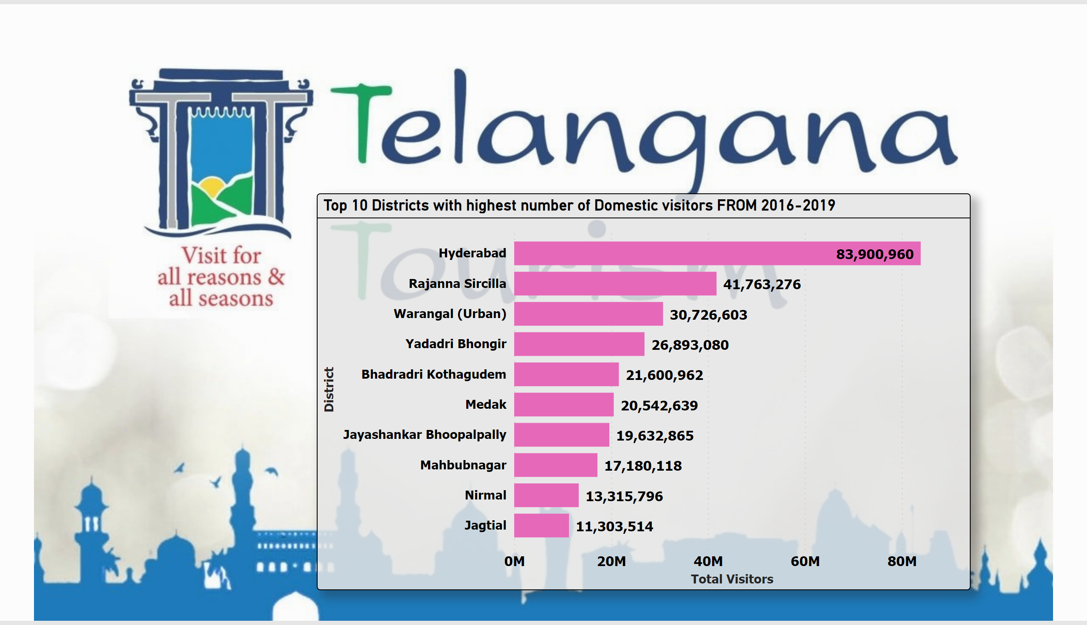
Question_1
Notes:
Top 10 Districts with highest number of Domestic visitors FROM 2016-2019
No alt text provided

Slide 4
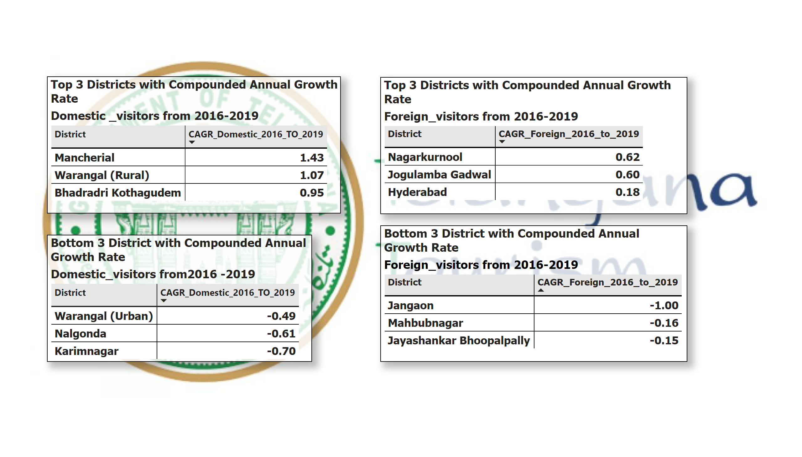
Question_2&3
Notes:
Top 3 Districts with Compounded Annual Growth Rate
No alt text provided
Top 3 Districts with Compounded Annual Growth Rate
No alt text provided
Bottom 3 District with Compounded Annual Growth Rate
No alt text provided
Bottom 3 District with Compounded Annual Growth Rate
No alt text provided

Slide 5
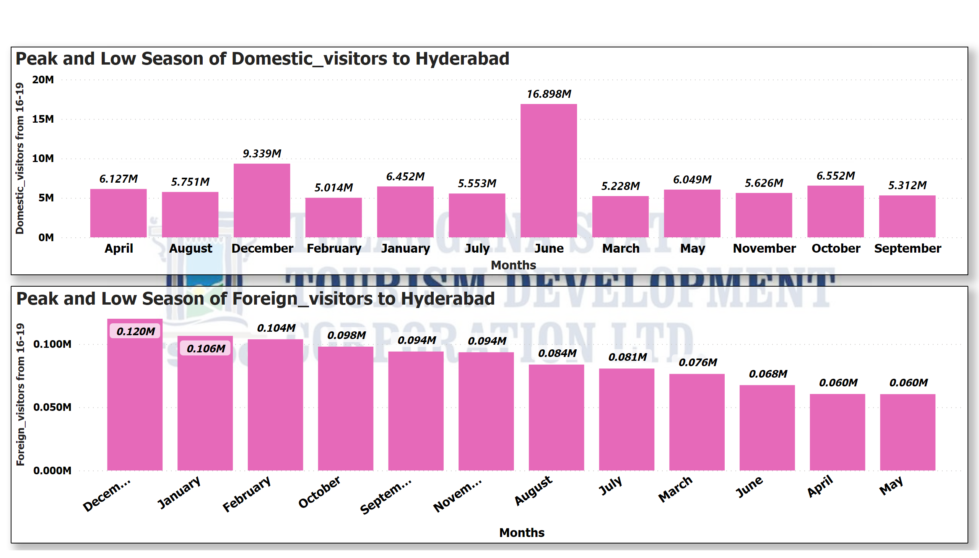
Question_4
Notes:
Peak and Low Season of Domestic_visitors to Hyderabad
No alt text provided
Peak and Low Season of Foreign_visitors to Hyderabad
No alt text provided

Slide 6
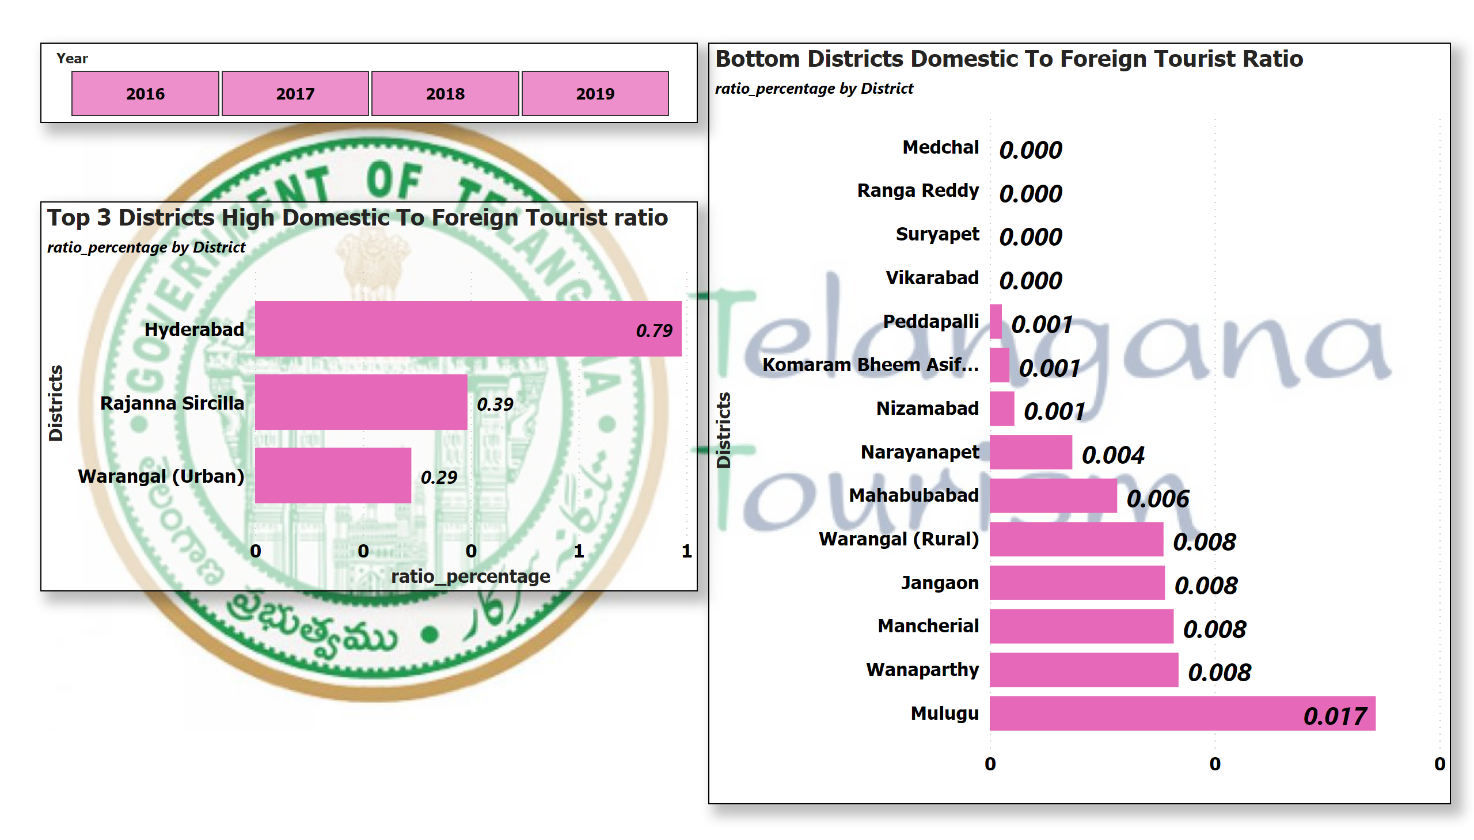
Question_5
Notes:
Top 3 Districts High Domestic To Foreign Tourist ratio
No alt text provided
Bottom Districts Domestic To Foreign Tourist Ratio
No alt text provided
slicer
No alt text provided

Slide 7
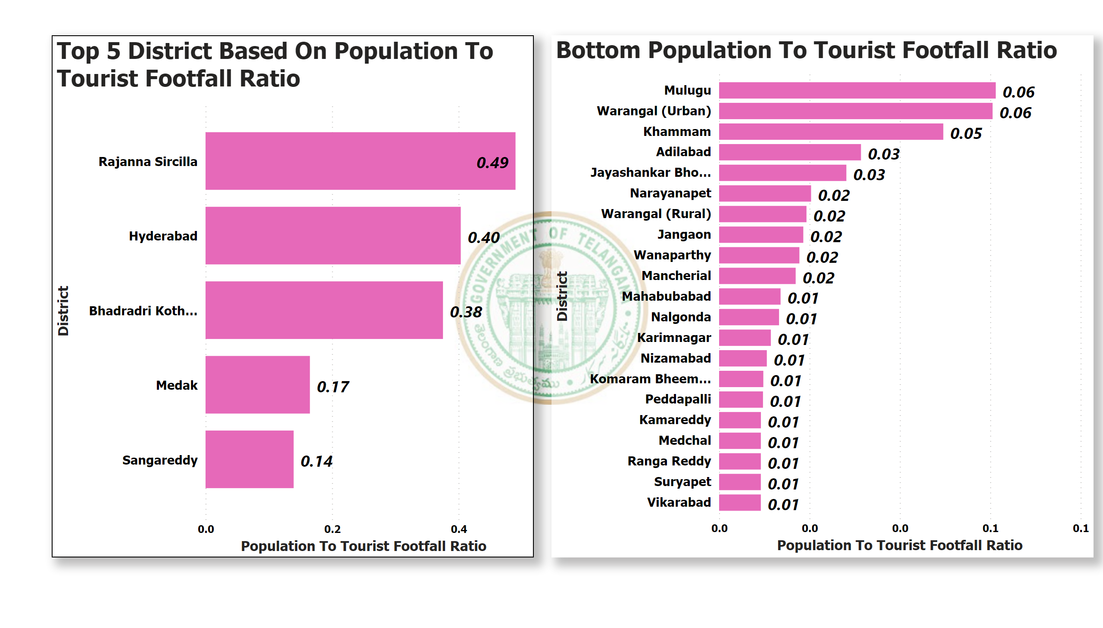
Question_6
Notes:
Top 5 District Based On Population To Tourist Footfall Ratio
No alt text provided
Bottom Population To Tourist Footfall Ratio
No alt text provided

Slide 8
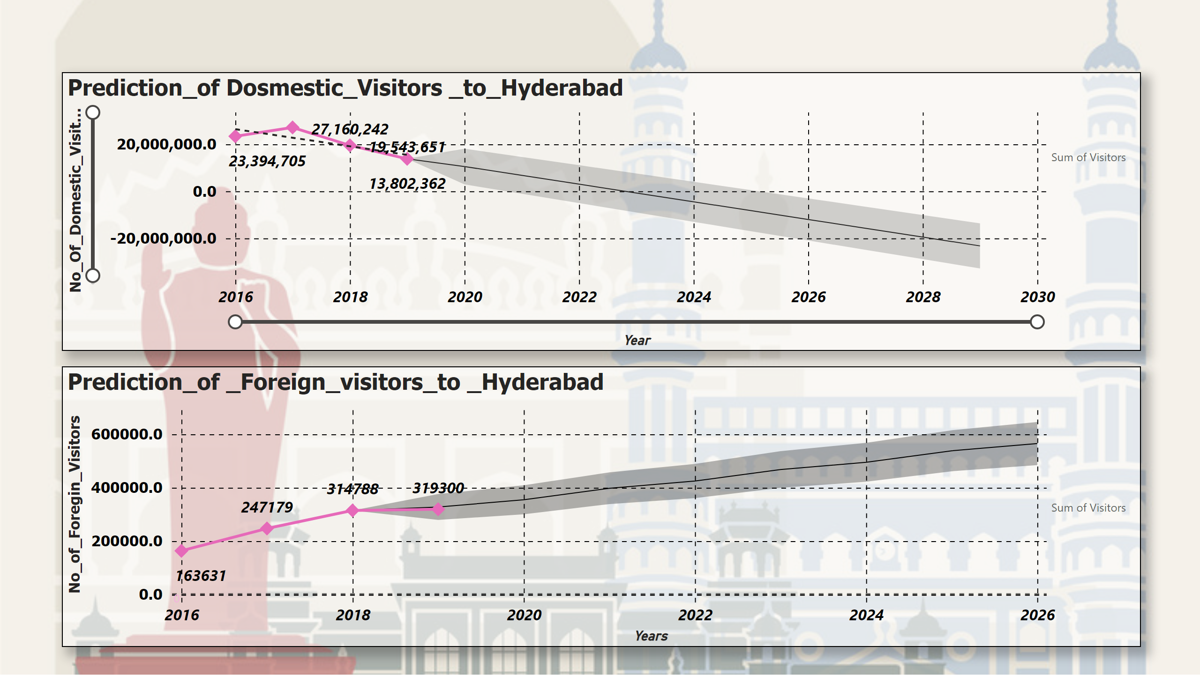
Question_7
Notes:
Prediction_of _Foreign_visitors_to _Hyderabad
No alt text provided
Prediction_of Dosmestic_Visitors _to_Hyderabad
No alt text provided

Slide 9
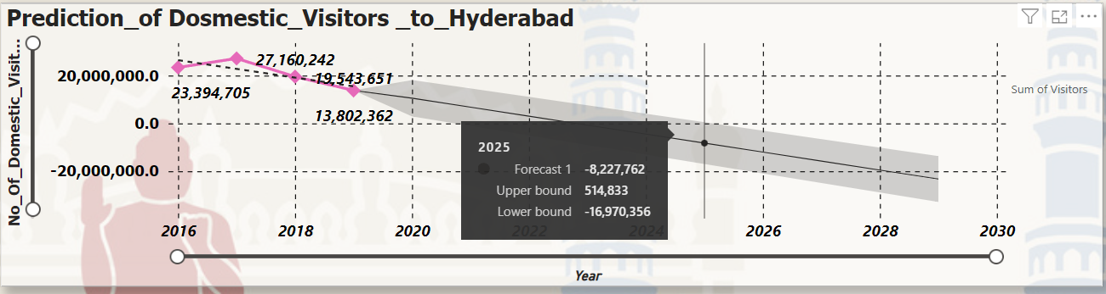
PROJECTED REVENUE FOR HYDERABAD 2025
Forecast Visitors = 15,166,943
Upper Bound = 15,681,776
Lower Bound = 13,363,530
Estimated Domestic _Visitors to_Hyderabad in 2025
Estimated Cost on single domestic visitor = 1,200 INR
Cost on Forecast Visitors = 18.2 B
Cost on Upper Bound = 18.8 B
Cost on Lower Bound = 16.03 B

Slide 10
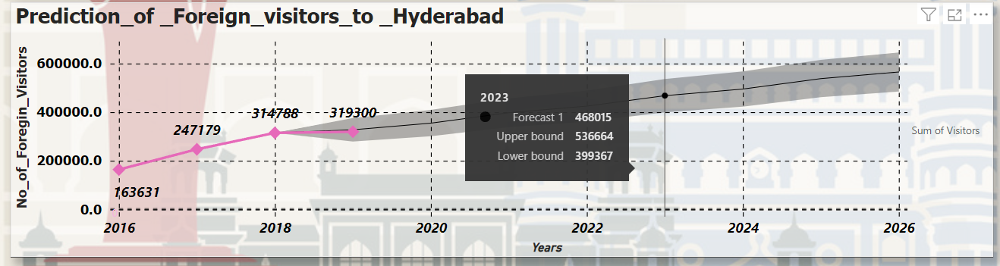
PROJECTED REVENUE FOR HYDERABAD 2025
Estimated Domestic _Visitors to_Hyderabad in 2025
Estimated Cost on single Foregin visitor = 5,600 INR
Cost on Forecast Visitors = 2.6 B
Cost on Upper Bound = 3.1 B
Cost on Lower Bound = 2.2 B
Forecast Visitors = 4,68,015
Upper Bound = 5,36,664
Lower Bound = 3,99,367

Slide 11
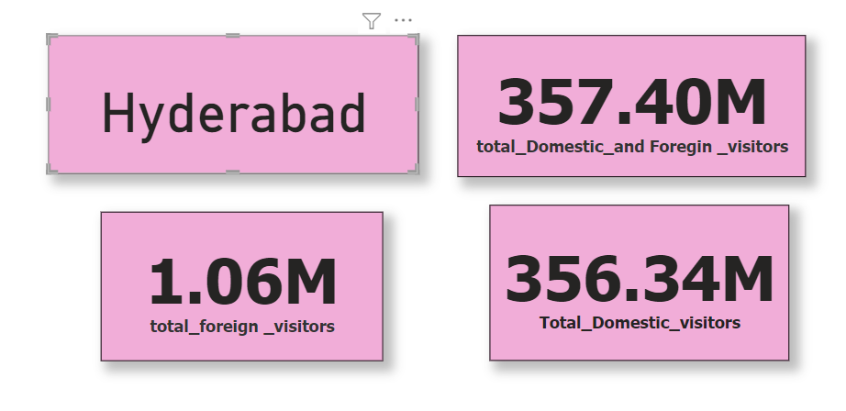
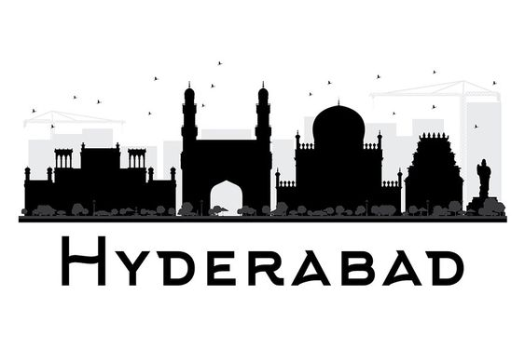
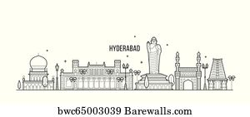
DISTRICT WITH THE HIGHEST POTENTIAL

Slide 12
CULTURE EVENTS TO BOOST TOURISM
CULTURE EVENTS :
Batthukamma
Ramzaan
Ganesh Chaturthi
Sammaka And Saraakka Jathara
Eid
CULTURE EVENTS :
Batthukamma: It is majorly celebrated in October or in the mid of September
Ramzaan: Majorly celebrated from March to April in Hyderabad
Ganesh Chaturthi: Majorly celebrated in August or September in Hyderabad
Sammaka And Saraakka Jathara: Majorly celebrated in February or March in Mulugu District
Eid: Majorly celebrated from June in Hyderabad

Slide 13
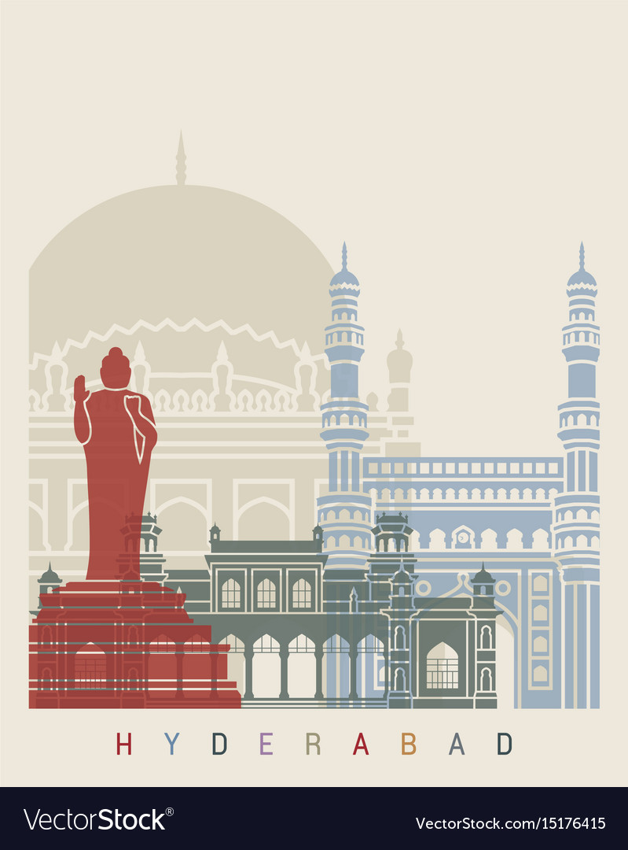
Can Hyderabad Emulate Dubai Model
The key success for Dubai for massive business model
Leadership
Visionary
ABS model: Attraction, Branding, and State-led development

Slide 14
Thank you

